Slide 1
Mini course: Graph theory Introduction
2nd March 2021

Slide 2
How do you characterize graphs? What to measure?
https://radiocrafts.com/why-is-multicasting-becoming-essential-for-mesh-networks/
https://physics-complex-systems.fr/complex-networks.html
https://en.wikipedia.org/wiki/Connectivity_(graph_theory)

Slide 3
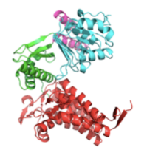
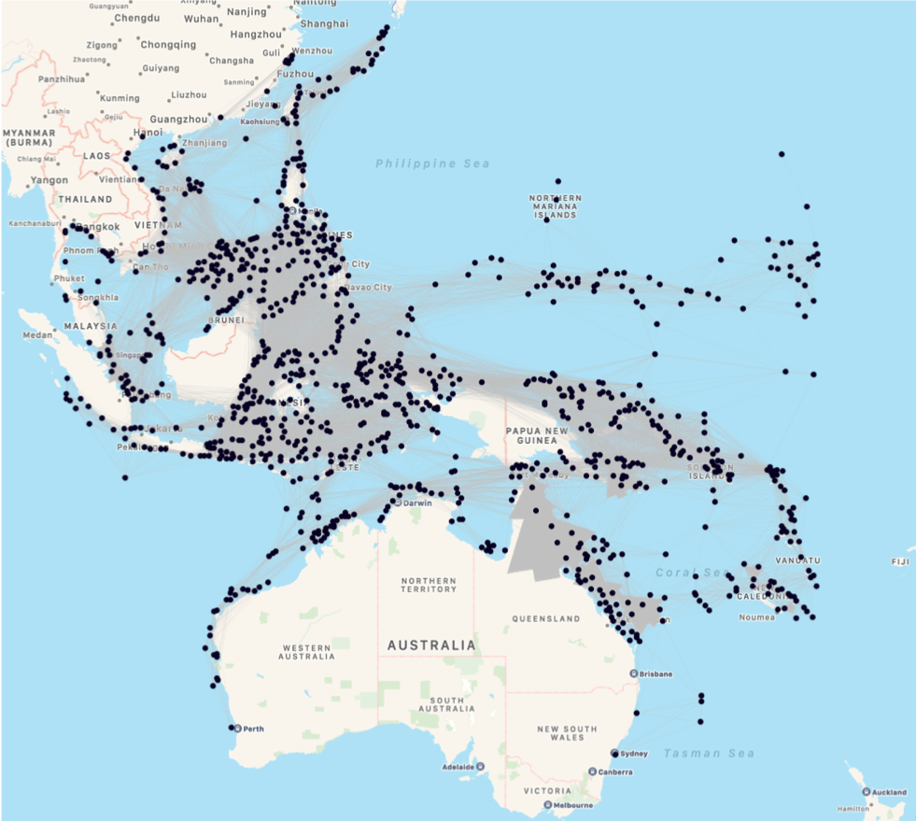
How do you characterize graphs? What to measure? (Q. does network topology represent/affect dynamics?)
Protein structure (Suzuki and Yura 2016)
US electricity grid (Global Energy Network Institute)
Co-authorship (Newman et al 2003 )
Metabolic network of E. coli (Guimera and Amaral 2005)
Dispersal network (Economo et al Unpublished)

Slide 4
Concepts and terminology
Vertex (node), edge (link), loop
Subgraph
Degree
Path
Directed vs undirected graph
Weighted graph
Classical graph examples

Slide 5
What is a graph
G = (V, E) where V: a set of vertices, E: a set of edges
Vertex (node), edge (link), loop
Subgraph

Slide 6
Degree (of a vertex)
The number of edges linked to a vertex
Degree distribution
(Degree centrality)

Slide 7
Paths
A (finite or infinite) sequence of edges which joins a sequence of vertices which are (by most definitions) all distinct.

Slide 8
Directed vs undirected graph

Slide 9
Weighted graph

Slide 10
Classical graph examples
Examples
Complete networks
Random networks (Erdős–Rényi model)
Small-world networks (Watts-Strogatz model) e.g. social networks, neural system in C. elegance, electricity network in the US, collaboration network of Hollywood actors
Scale-free network (Barabási–Albert model) e.g. WWW
Notes:
Create graphs using Networkx

Slide 11
A little more advanced concepts
Trees and forests Tree: an undirected graph in which any two vertices are connected by exactly one path. Forest: an undirected graph in which any two vertices are connected by at most one path, or equivalently an acyclic undirected path.
Minimum spanning tree
These edges, a subset of the edges of the connected graph, connect all the vertices.
https://en.wikipedia.org/wiki/Minimum_spanning_tree

Slide 12
A little more
Connectivity: an interest we may have in graph theory is whether nodes are connected or disconnected.
Components (strongly, weakly connected components)
https://en.wikipedia.org/wiki/Connectivity_(graph_theory)
https://en.wikipedia.org/wiki/Component_(graph_theory)
Notes:
Mention island connectivity

Slide 13
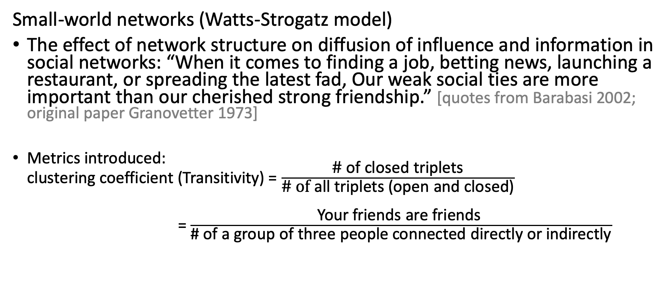
Link between dynamics and network topology by statistical characteristics by graph models
Small-world networks (Watts-Strogatz model)
The effect of network structure on diffusion of influence and information in social networks: “When it comes to finding a job, betting news, launching a restaurant, or spreading the latest fad, Our weak social ties are more important than our cherished strong friendship.” [quotes from Barabasi 2002; original paper Granovetter 1973]
Metrics introduced: clustering coefficient (Transitivity) = $\frac{\text{\#} \text{of} \text{closed} \text{triplets}}{\text{\# }\text{of} \text{all} \text{triplets}\text{ (}\text{open} \text{and} \text{closed}\text{)}}$
= $\frac{\text{Your} \text{friends} \text{are} \text{friends} }{\text{\# }\text{of} \text{a} \text{group} \text{of} \text{three} \text{people} \text{connected} \text{directly} \text{or} \text{indirectly}}$

